Slide 1

PRIORITY BASED TASK SCHEDULING FOR HEALTHCARE IOT USING EDGE COMPUTING
23CSE362 Edge Computing
Review 2
24_HeartAttack
E.C Team Members:
CB.SC.U4CSE23443 : SIDHARTH S NAIR
CB.SC.U4CSE23448 : SRIJA K
CB.SC.U4CSE23449 : SUHAS NETHI
CB.SC.U4CSE23465 : SISTHICK S
C.I Team Members:
CB.SC.U4CSE23625 : K CHAKRESWAR SIVA KUMAR
CB.SC.U4CSE23635 : NANDIGAM PRAKYATH

Slide 2

PROBLEM STATEMENT
“ Prioritize and schedule continuously incoming healthcare tasks on edge nodes based on urgency “
Continuously incoming tasks/data from sensor layer
Dynamic assigning of priority to each of the task based on urgency
Scheduling tasks in edge or cloud layers based on priority specifications
Source Material: Journal of King Saud University – Computer and Information Sciences

Slide 3
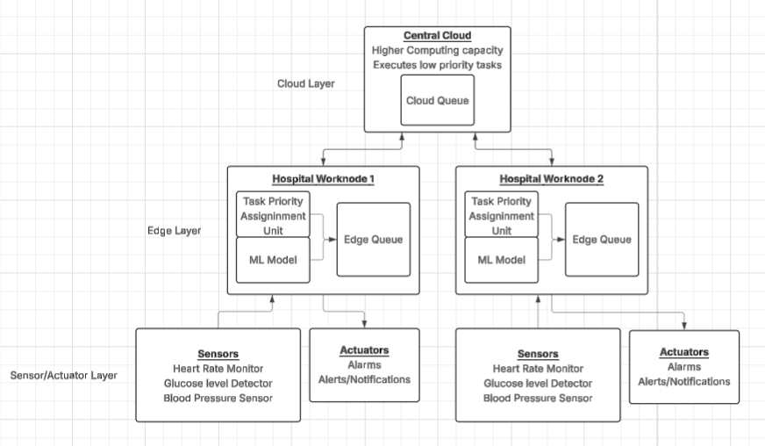
UPDATED ARCHITECTURE DIAGRAM

Slide 4
IFOGSIM2 SIMULATOR
Simulation Tool: iFogSim2 (Java + Eclipse)
Simulated devices - sensor, actuator, edge node, a cloud server
Simulated environment includes a sensor which takes Heart_Rate, Blood_Pressure and Glucose_Level and alarm which is connected to edge nodes (Hospital Workstations) and a cloud interface for offloading tasks

Slide 5
IMPLEMENTATION SO FAR
Edge Node, Cloud Node, Sensor and Actuator is created
Sensor readings are read through a csv file in the form of (patient_id , heart_rate , blood_pressure , glucose_level)
Sensor readings are converted to tasks and assigned a priority value by the priority calculation function
Tasks assigned into Edge or Cloud Queue based on ‘k’ value and Actuator output as per condition
Implemented a trained ML model capable of generating ‘k’ value for a wider demographic

Slide 6
TO BE IMPLEMENTED
Scheduling tasks in the devices instead of priority queues
Hardcoded patient data to differentiate between “general” and “specific” patients
Integration of the ML model into the edge computing architecture so that the “general” tasks assigned priority by the priority function while the “specific” tasks utilize the ML model

Slide 7
NEW APPROACHES TO BE CONSIDERED IN IMPLEMENTATION
Hardcoded patient data (patient_id , age , height , weight , type) for each edge nodes. The type has “general” and “specific” as values
“specific” data to be assigned priority value using a highly trained ML model. Helps in calculating priority value for patients outside standard reference ranges
A new priority value ‘m’ which is solely based on the parameters affecting the existing priority value ‘k’ , acting as a tie breaking mechanism

Slide 8
CODE WALKTHROUGH

Slide 9
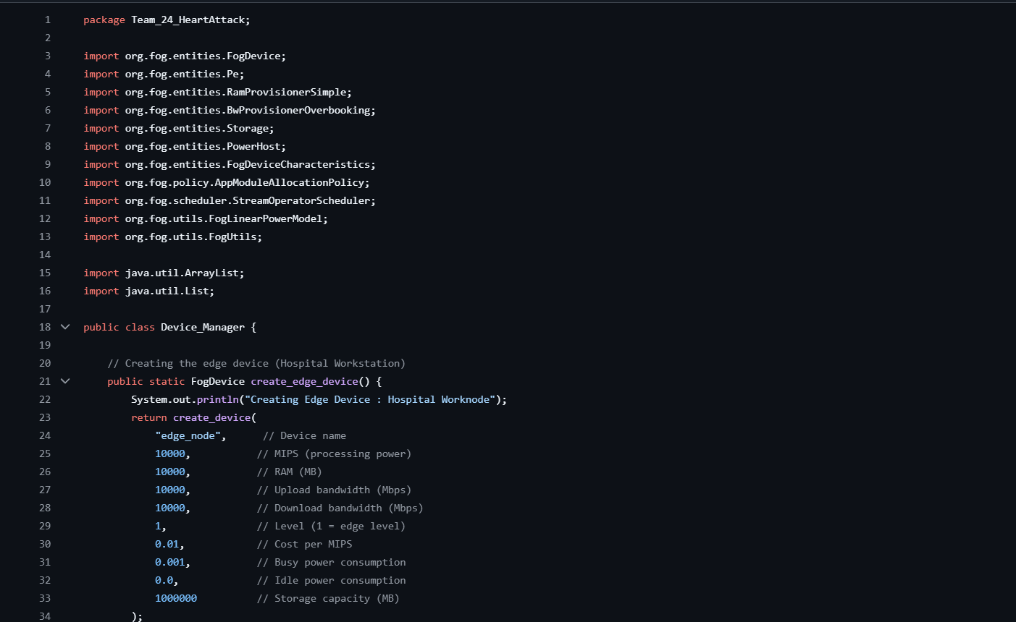
DEVICE MANAGER (SUHAS NETHI)

Slide 10
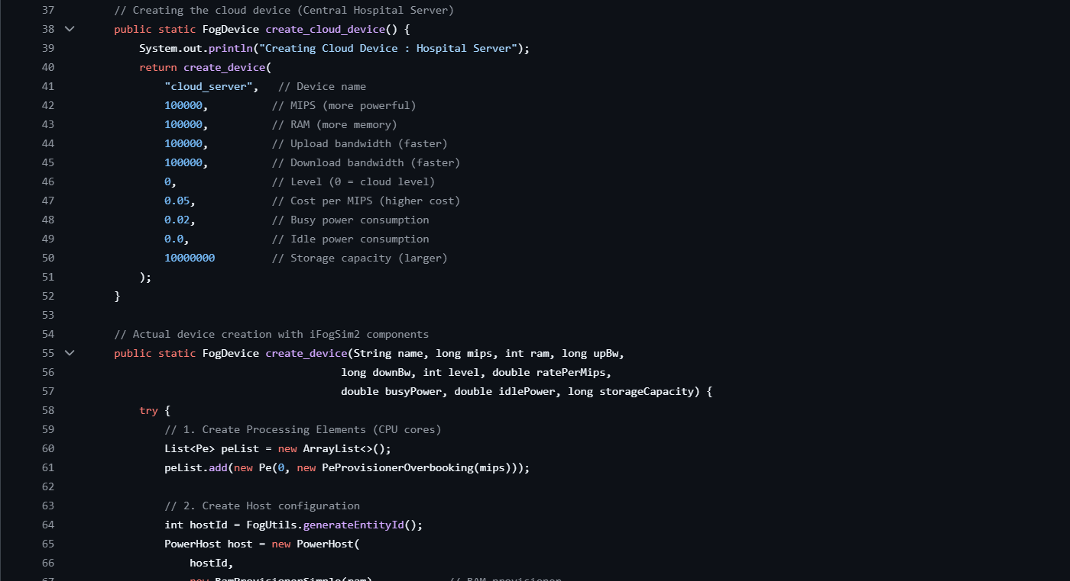
DEVICE MANAGER (SUHAS NETHI)

Slide 11
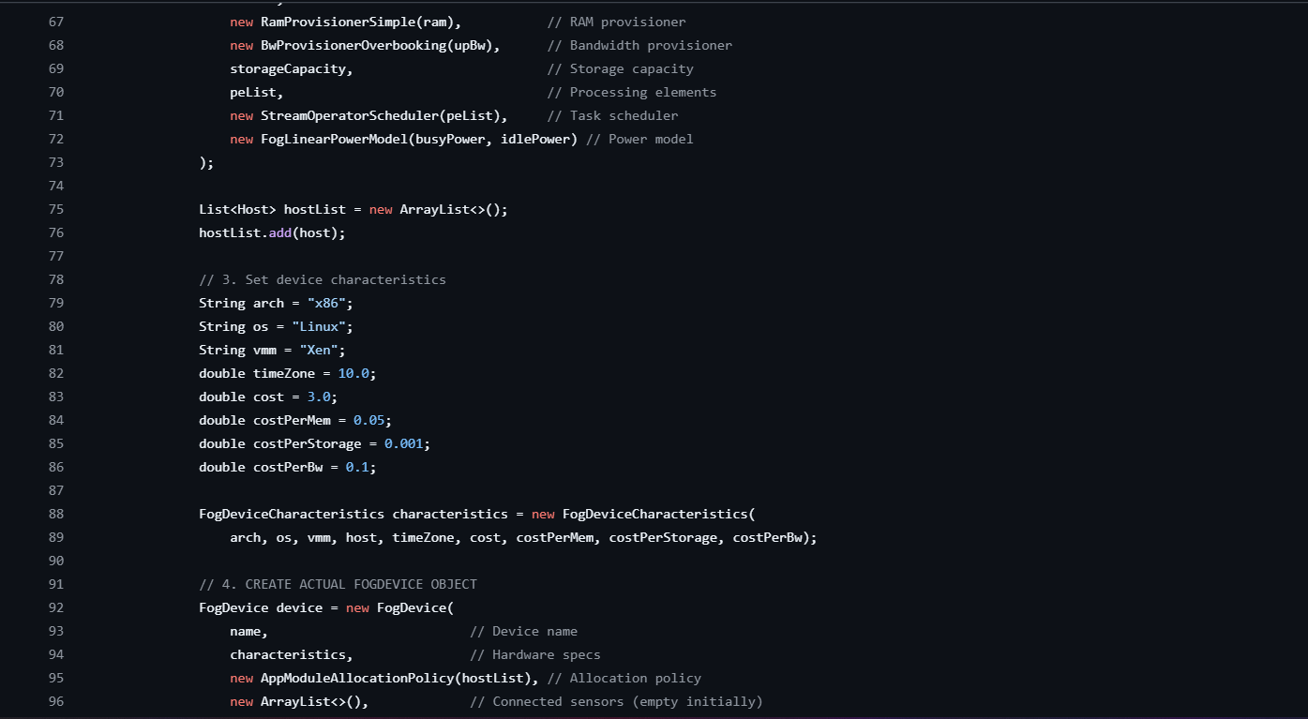
DEVICE MANAGER (SUHAS NETHI)

Slide 12
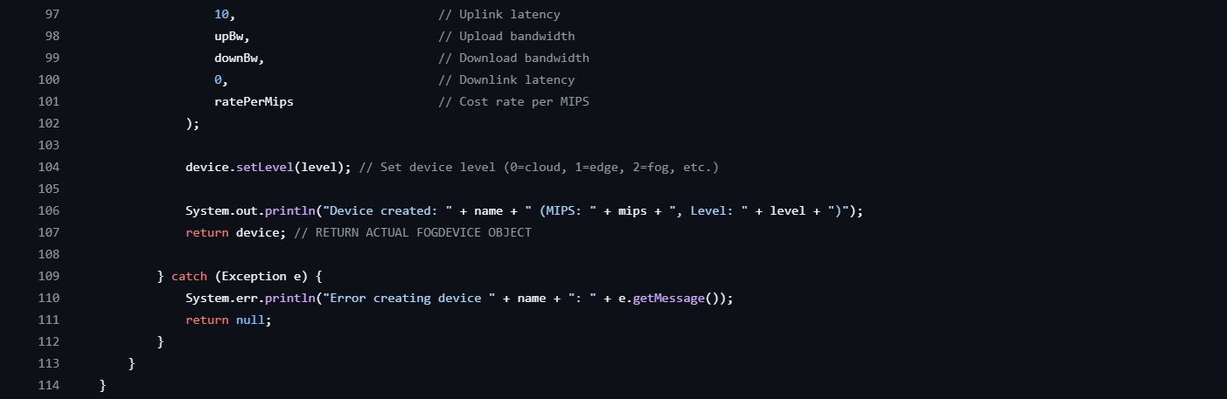
DEVICE MANAGER (SUHAS NETHI)

Slide 13
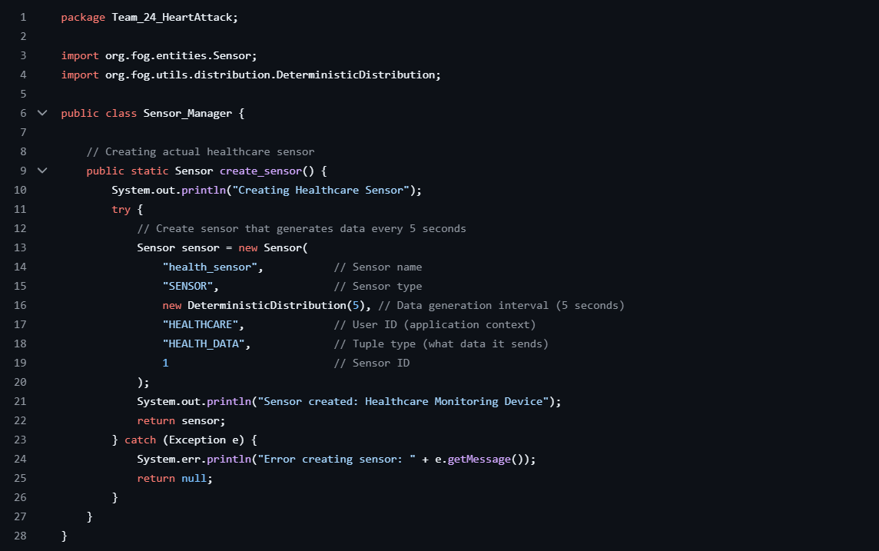
SENSOR MANAGER (SRIJA K)

Slide 14
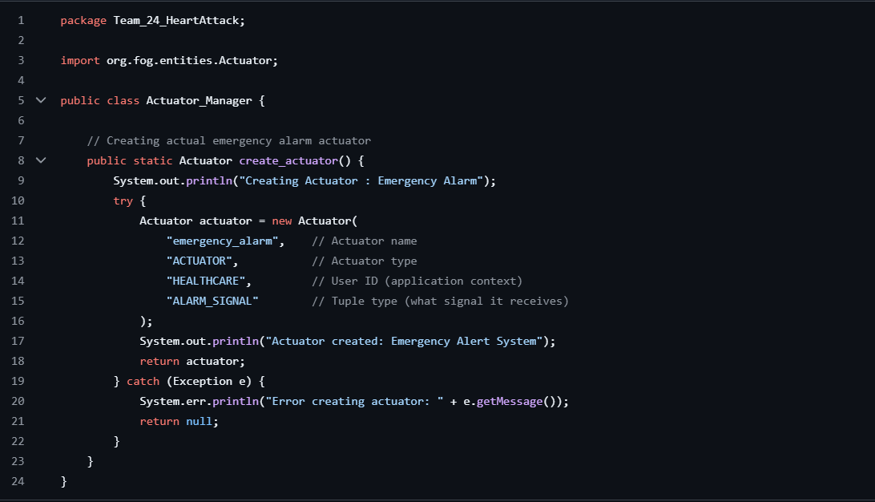
ACTUATOR MANAGER (SRIJA K)

Slide 15
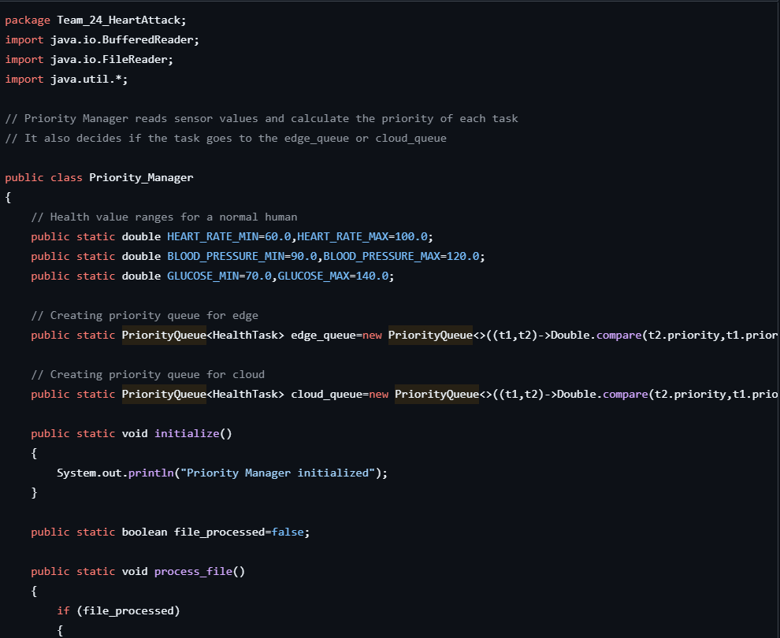
PRIORITY MANAGER
(SIDHARTH S NAIR)

Slide 16
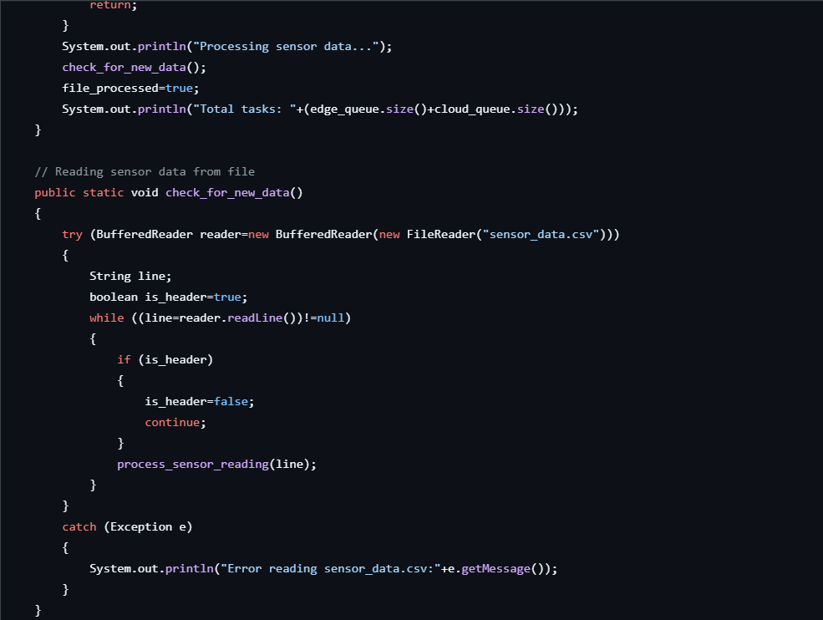
PRIORITY MANAGER
(SIDHARTH S NAIR)

Slide 17
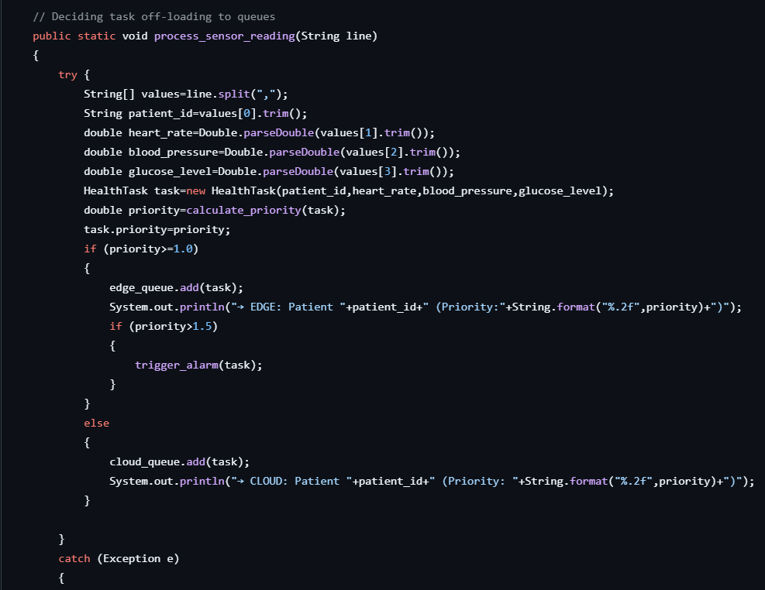
PRIORITY MANAGER
(SIDHARTH S NAIR)

Slide 18
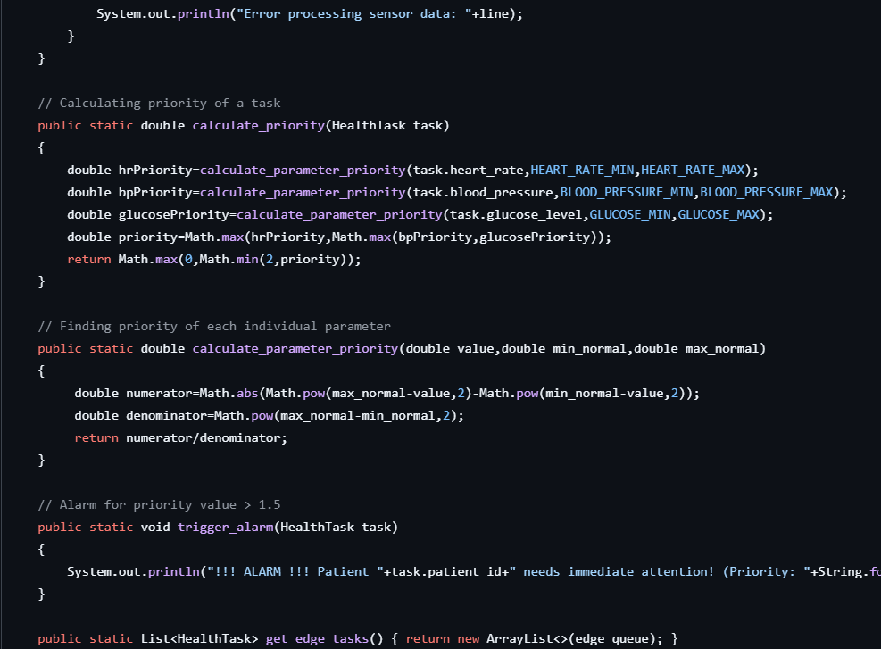
PRIORITY MANAGER
(SIDHARTH S NAIR)

Slide 19
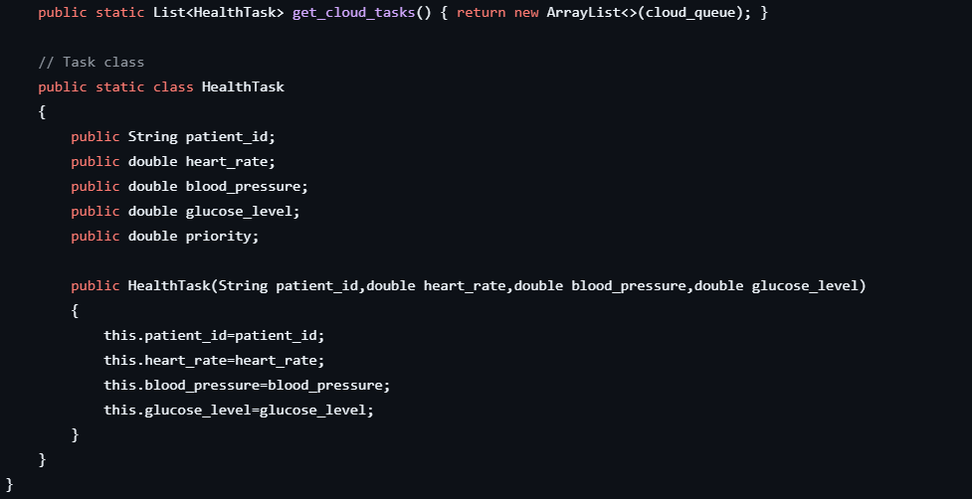
PRIORITY MANAGER
(SIDHARTH S NAIR)

Slide 20
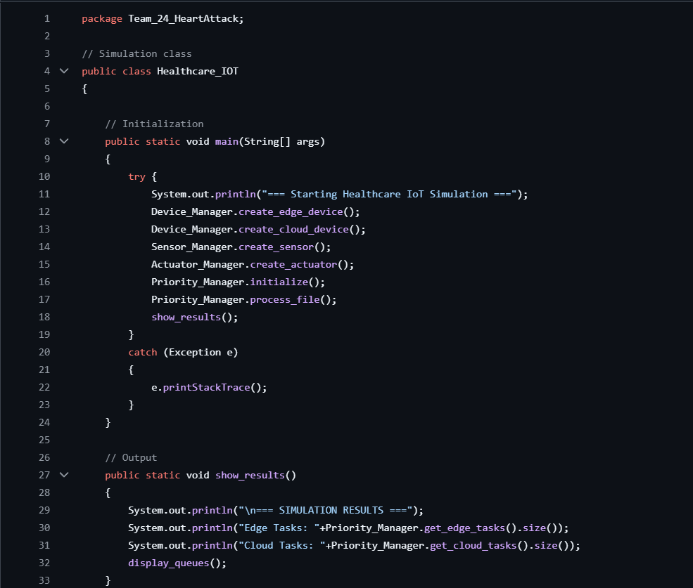
HEALTHCARE_IOT (SISTHICK S)

Slide 21
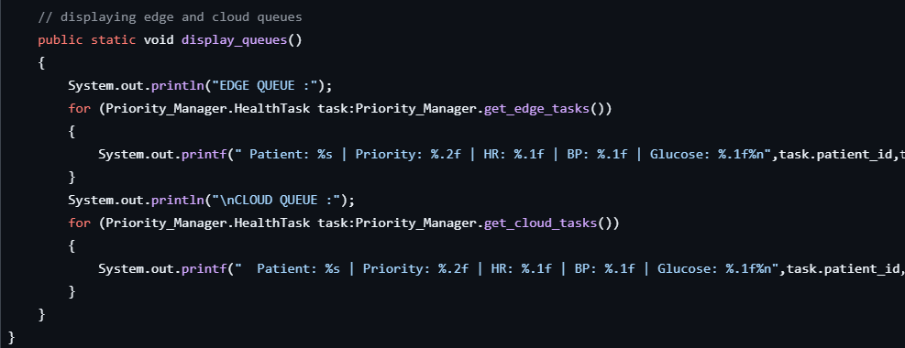
HEALTHCARE_IOT (SISTHICK S)

Slide 22
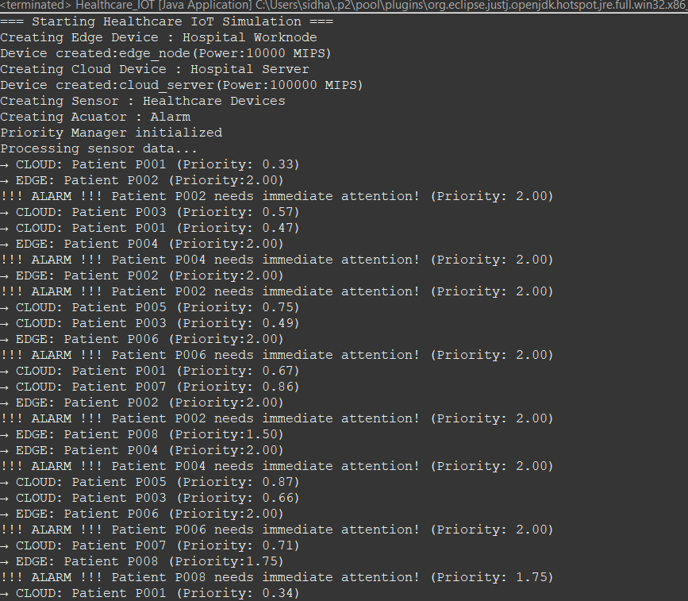
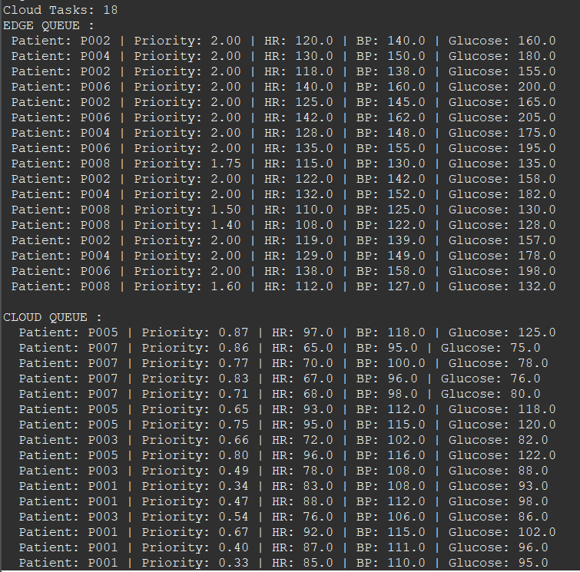
SAMPLE OUTPUT
(PRIORITY FUNCTION)

Slide 23
CI TECHNIQUE USED IN THE ML MODEL
We use the RandomForest Regressor, a Computational Intelligence technique. RandomForest is an ensemble learning method that combines multiple decision trees to improve stability and accuracy.
The model is trained on the patient dataset (patient_data.csv) using features Heart rate, blood pressure, glucose, age, weight, and height. After training, the model is applied to new patient records (test_data.csv).
How prediction works: (1) Each decision tree makes a numerical prediction of the patient’s risk level. (2) The predictions are averaged across trees to get the final risk score.

Slide 24
WHY RANDOMFOREST?
Logistic Regression → Simple, but assumes linear relationships; may miss complex health risk patterns.
K-Nearest Neighbors (KNN) → Easy to implement, but slow with large datasets and sensitive to irrelevant features.
Support Vector Machine (SVM) → Accurate, but requires heavy parameter tuning and is computationally expensive.
RandomForest → Balances accuracy, speed, and robustness by combining many decision trees.

Slide 25
WHY RANDOMFOREST WORKS BEST?
Handles noisy and missing medical data effectively.
Provides high prediction accuracy without severe overfitting.
Works well with multiple patient features (HR, BP, glucose, etc.).
Requires less parameter tuning compared to SVM or Neural Networks.
Offers feature importance insights, showing which health factors impact predictions most.
Scales efficiently as more patient data becomes available, making it suitable for large hospital/IoT deployments.

Slide 26
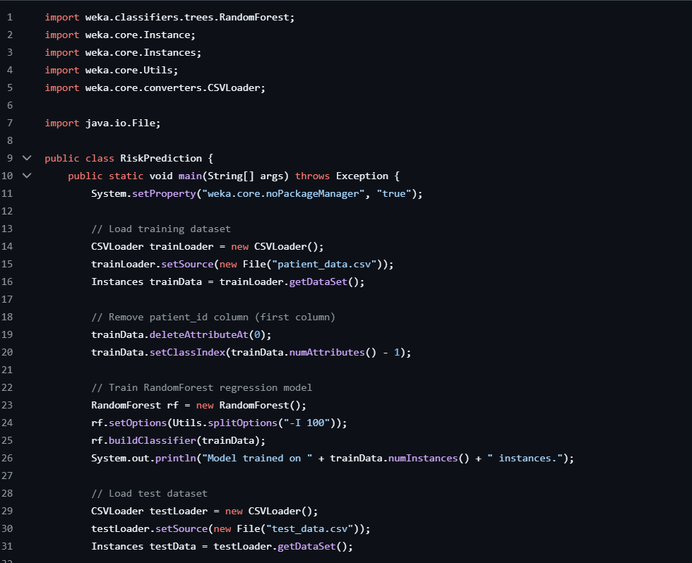
RISK PREDICTION

Slide 27
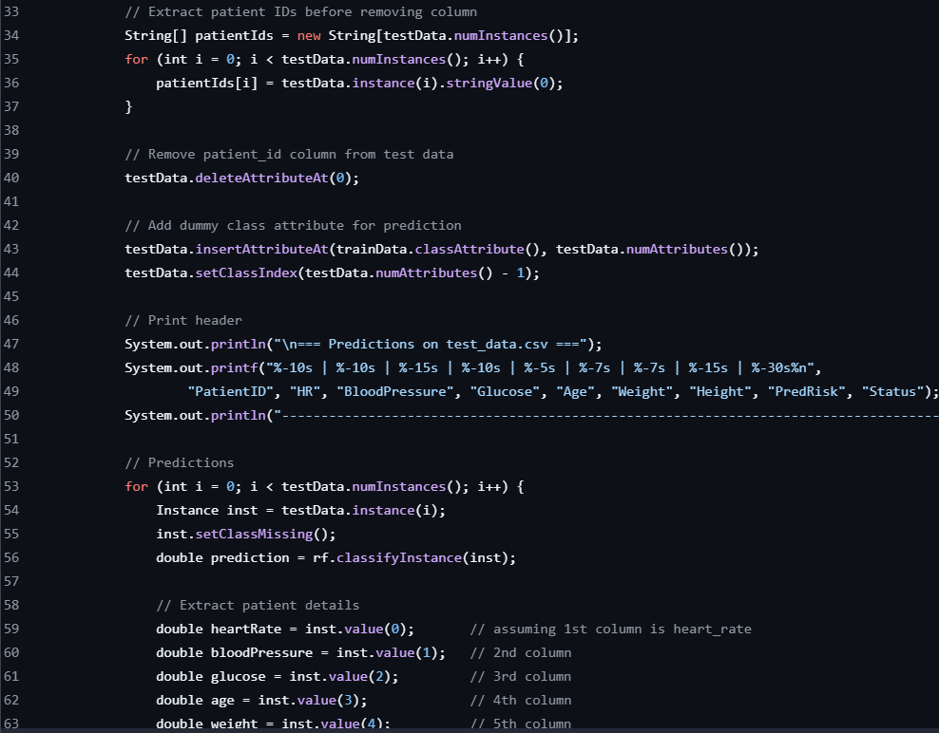
RISK PREDICTION

Slide 28
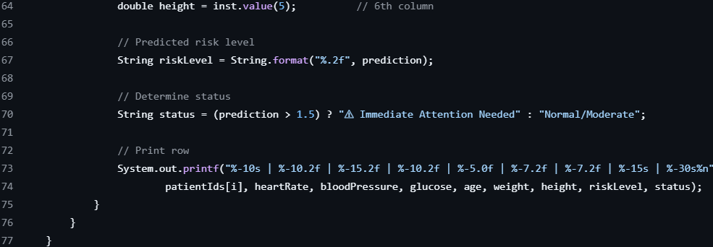
RISK PREDICTION

Slide 29
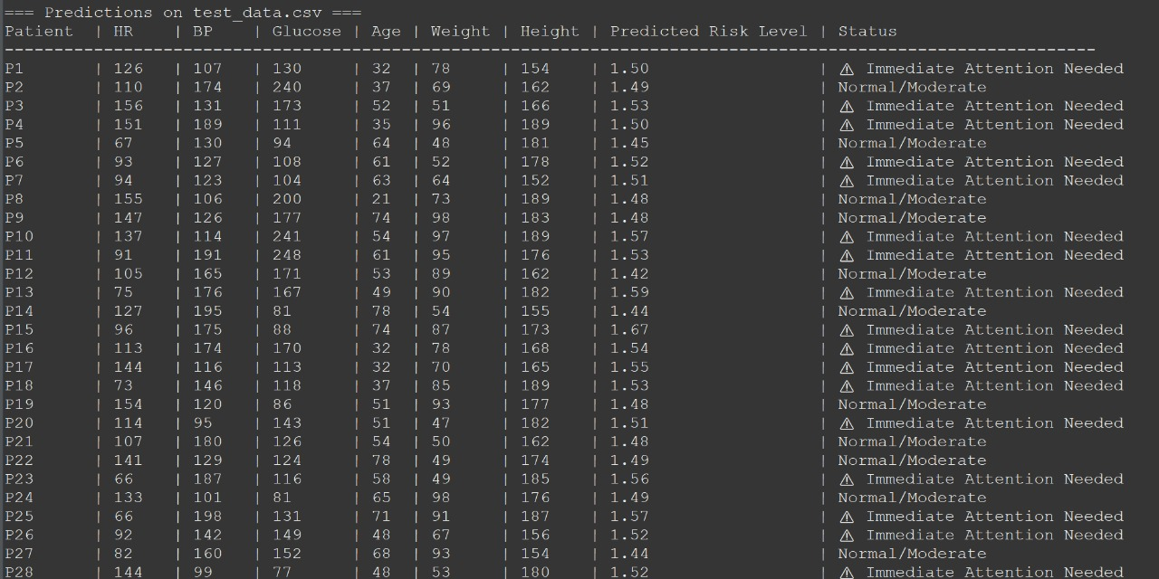
SAMPLE OUTPUT (ML MODEL)

Slide 30
THANK YOU
ANY QUERIES?

